Slide 1
A cellular automata model on economic behavior
Emily Baczyk
Andrés Barreneche
Stefano Nichele
Christoforos Somarakis
June 13 – June 17 2011
MIT, Cambridge MA

Slide 2
Outline
A Dynamic Rule in Cellular Automata
Elements of Cellular Automata Theory
The base-model (to appear in ICCS2011).
Definition
Overview of results
Remarks
The new model
Basic principles
Definition
Monitored quantities, statistical analysis
Simulations
Analysis of the results

Slide 3
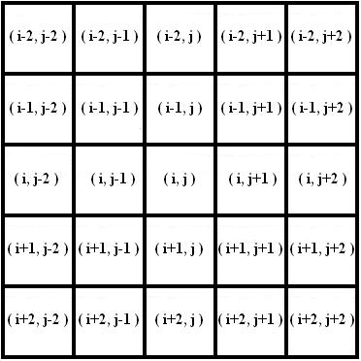
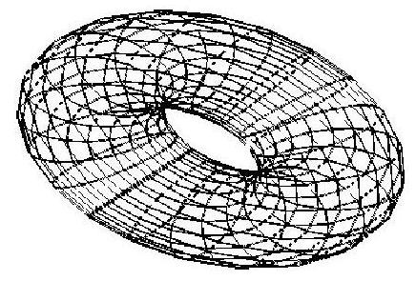
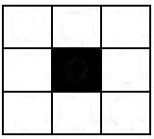
Introduction
A Dynamic Rule in Cellular Automata
Definitions:
State space – 2D lattice L = {x : x = (i , j) , i, j =1,2,3...}
Local value space – σ(x ; t) = {0,1} ({black, white})
Neighborhood of a cell x – the Moore scheme
Boundary Conditions – periodic (torus)
Update rule – The F-rule
Cellular automata: Spatially and temporally discrete dynamical systems. Modeled as a grid of cells, where each cell gets a state after interacting with its neighbors.

Slide 4
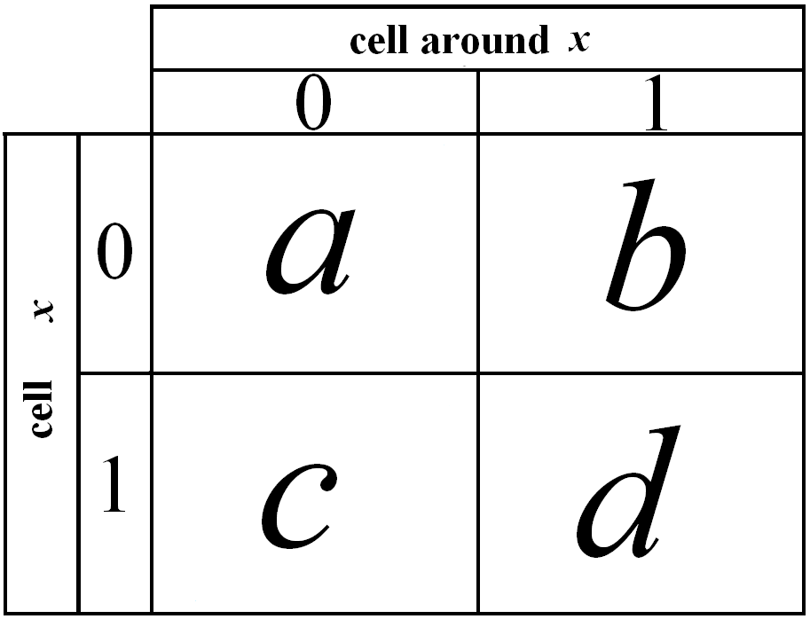
The F – rule
A Dynamic Rule in Cellular Automata
cost function
update function
F
Table of costs.
The cell “looks” at it’s neighbors and imitates the state of the “richest” one.

Slide 5
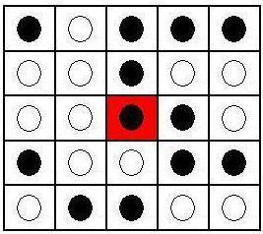
The F – rule
A Dynamic Rule in Cellular Automata
Description of the model
f₁ : G(t) → J(t)
F =
f₂: J(t) → G(t+1)

Slide 6
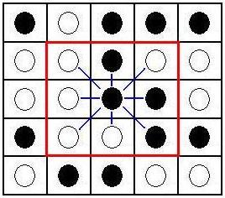
The F – rule
A Dynamic Rule in Cellular Automata
Description of the model
f₁ : G(t) → J(t)
F =
f₂: J(t) → G(t+1)

Slide 7
Remarks on the model
A Dynamic Rule in Cellular Automata
A deterministic version of probabilistic models such as the Ising Model [2] or games such as the Prisoner’s Dilemma [3].
Complex
Collective behavior emerging out of local interactions.
Constant value costs
Memoryless
Value costs are set to zero at the end of every turn
Abstract
Too simple. Doesn’t really describe any realistic behavior.

Slide 8
The new model
A Dynamic Rule in Cellular Automata
Design principles: (rich / poor individuals interacting)
Principles:
A collection of individuals forms an interacting society.
Social interaction creates “wealth”.
“Wealth” is created out of local interaction and distributed out of global interaction.

Slide 9
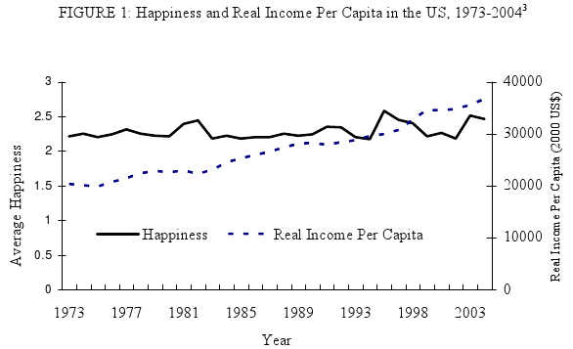
The new model
A Dynamic Rule in Cellular Automata
Design principles: (rich / poor individuals interacting)
Individuals determine whether they perceive themselves as “rich” or “ poor”, by comparing their “wealth” locally (road to “happiness”).
Relative income hypothesis: “life satisfaction is negatively affected when they perceive themselves to be economically inferior relative to their peers.”
A. Clark, P. Frijters, and M. Shields (2008) [4]

Slide 10
The new model
A Dynamic Rule in Cellular Automata
Properties:
The phase space is a society of individuals.
At each time step an individual is either poor (state: 0) or rich (state: 1).
The individuals gain an overall income every time step and store it. [memory]
The interaction is not only local (base model) but has also a global component.
The costs values are not constant.

Slide 11
The new model
A Dynamic Rule in Cellular Automata
Notations & Definitions:
Individual
Instant state :
Instant income:
Stored income (Savings):
Neighborhood:
Increasing / Decreasing weight functions:
Social distributed income:
Modified cost function and update function

Slide 12
The new model
A Dynamic Rule in Cellular Automata
Design principles (rich / poor individuals interacting)
A poor (state 0) individual will:
increase its income out of local interaction with a rich (state 1) individual
decrease its income out of local interaction with poor (state 0) individuals
increase its income out of global interaction (e.g. social services)

Slide 13
The new model
A Dynamic Rule in Cellular Automata
Design principles (rich / poor individuals interacting)
A rich (state 1) individual will:
increase its income out of local interaction with rich (state 1) individuals
decrease its income out of local interaction with poor (state 0) individuals
decrease its income out of global interaction (e.g tax payers)

Slide 14
The new model
A Dynamic Rule in Cellular Automata
Design principles: (rich / poor individuals interacting)
Update Rule:
An individual will calculate the average of the savings of its neighbors and compare it with its own savings.
It will declare itself rich only if its own savings are equal or higher than it’s neighbors.
Essence of the rule: “Rich” or “poor” is about perception.

Slide 15
The new model
A Dynamic Rule in Cellular Automata
Degrees of Freedom
Local interaction positive/negative income parameters: b, d / a,c
Global interaction income tax parameters: k, l
Setup
50 by 50 torus of cellular automata.
2oo iteration steps.
An amount of money is initially distributed to automata by normal distribution.
Monitored Quantities
Savings
Individual (Actual Wealth of each automaton)
1.2. Social (Sum of Savings; GDP)
Perceived Wealth (Rich or Poor)
GINI index

Slide 16
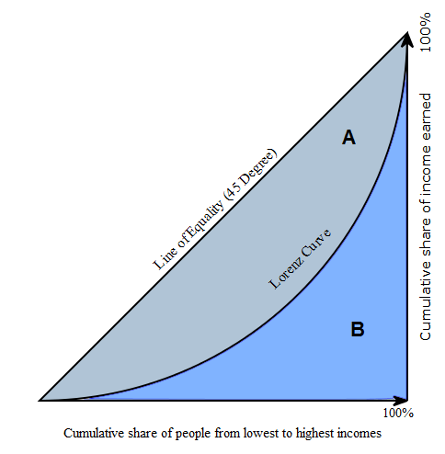
GINI coefficient (Corrado Gini, 1912)
A Dynamic Rule in Cellular Automata
G = A / ( A + B ) =
= A / 0.5 = 2A = 1 - 2B
Lorenz Curve: cumulative distribution function
of the empirical probability distribution of wealth
Y = L(X)
Sweden 23
Namibia 70

Slide 17
Simulation Scenarios
A Dynamic Rule in Cellular Automata
Population = 50 by 50 = 2500 / Steps = 200
Initial Conditions
Equality (Gini ≈0.2)
Inequality (Gini≈0.7)
Scenario A:
Scenario B:
Scenario C:
Scenario D:
Total Scenarios = 8

Slide 18
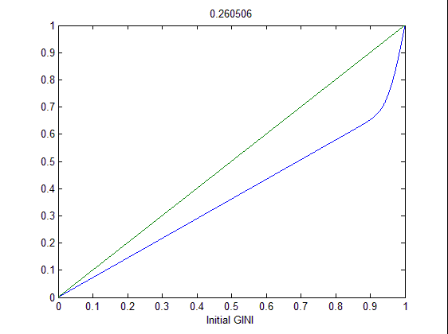
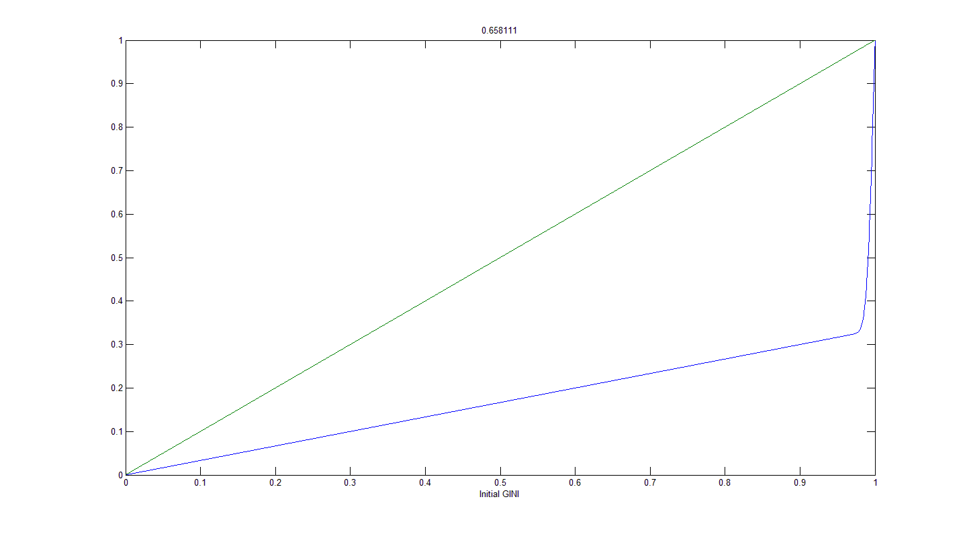
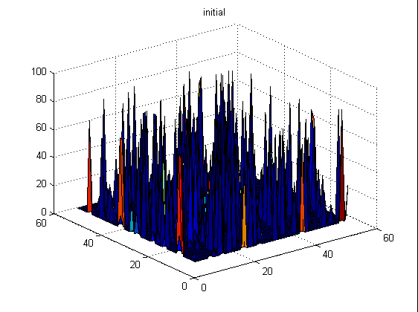
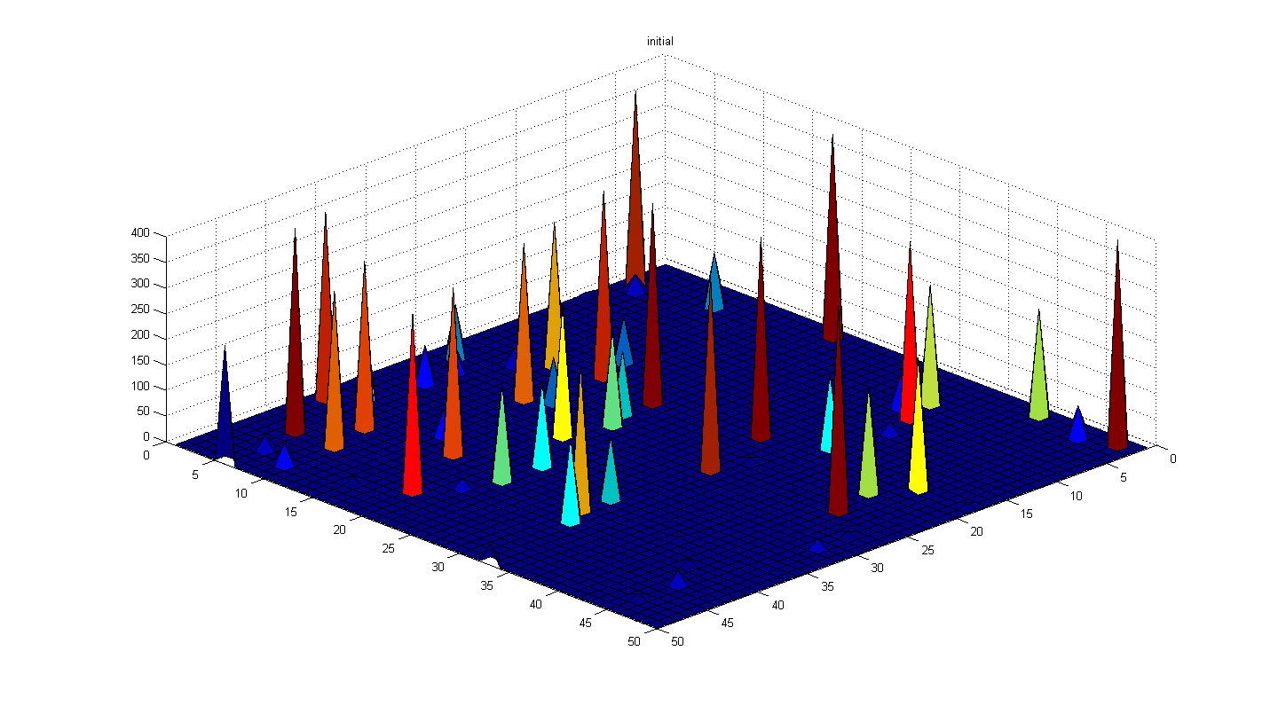
Initial Conditions
A Dynamic Rule in Cellular Automata
I. Equality (Gini ≈0.25) II. Inequality (Gini≈.065)

Slide 19
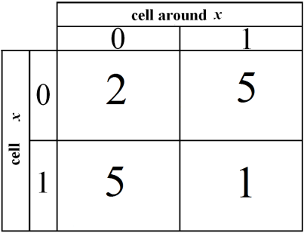
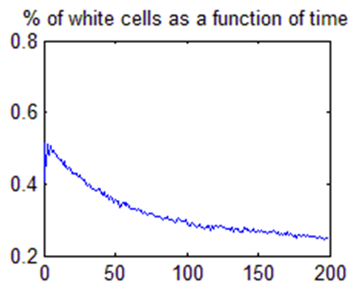
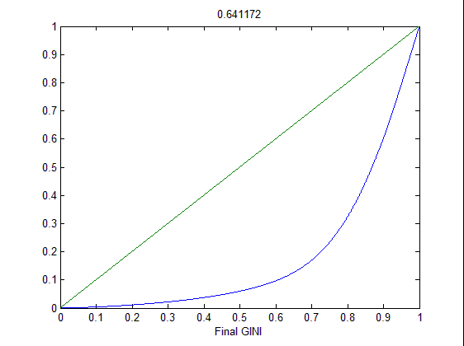
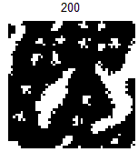
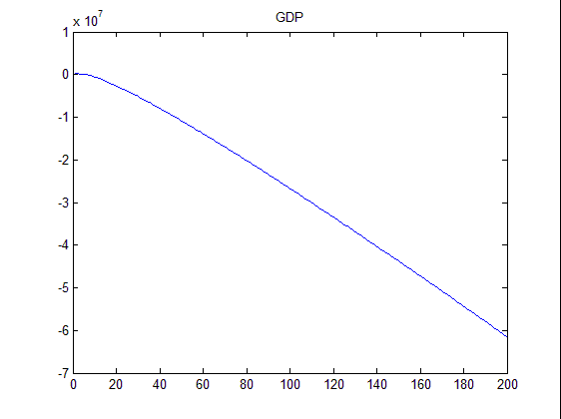
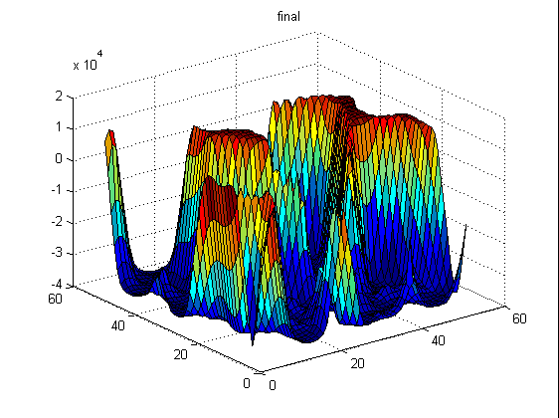
Simulation Scenarios – I.A.
A Dynamic Rule in Cellular Automata
k = 1
l = 1

Slide 20
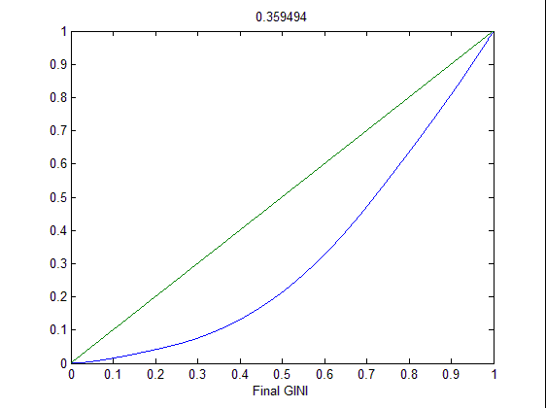
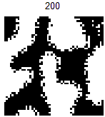
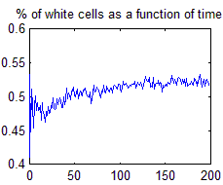
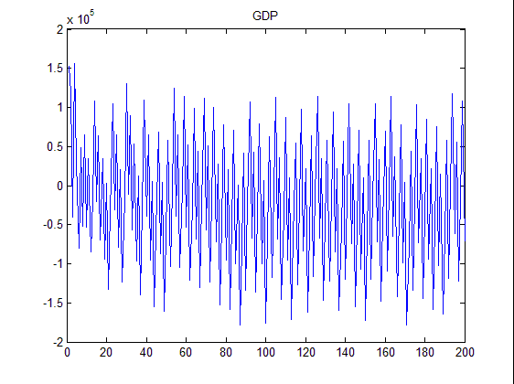
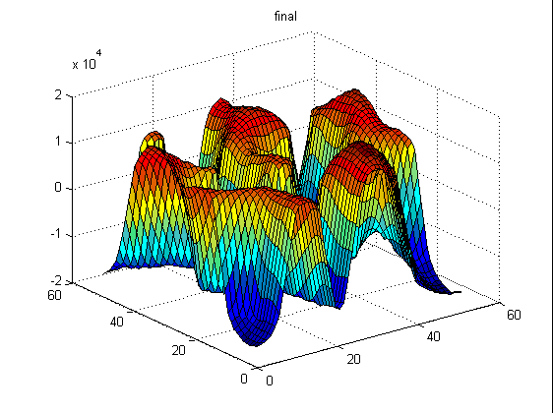
Simulation Scenarios – I.B.
A Dynamic Rule in Cellular Automata
k = 3
l = 3

Slide 21
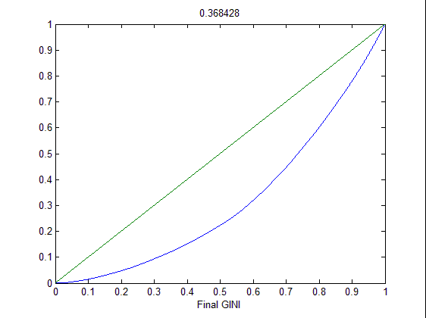
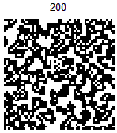
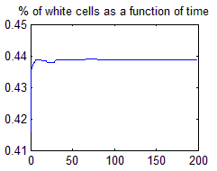
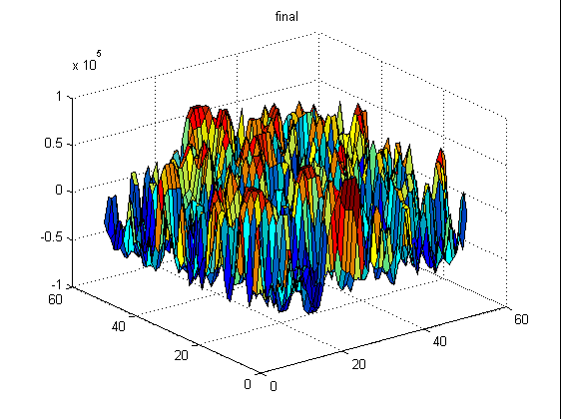
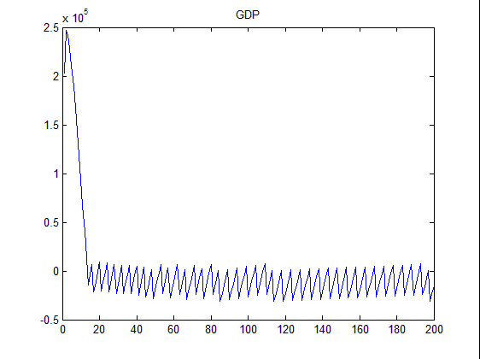
Simulation Scenarios – I.C.
A Dynamic Rule in Cellular Automata
k = 1
l = 1

Slide 22
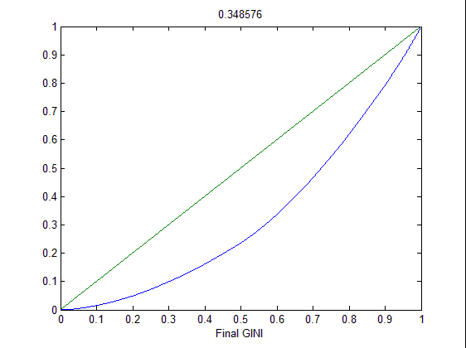
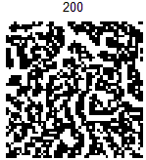
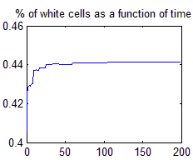
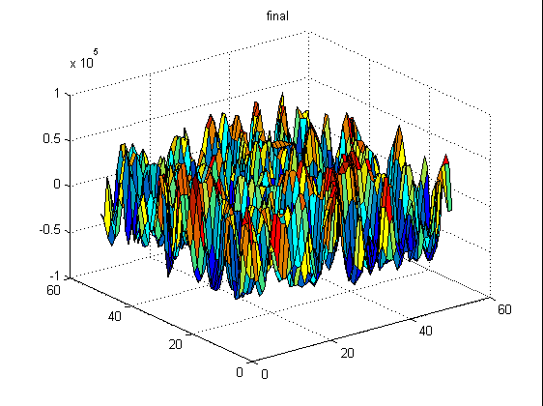
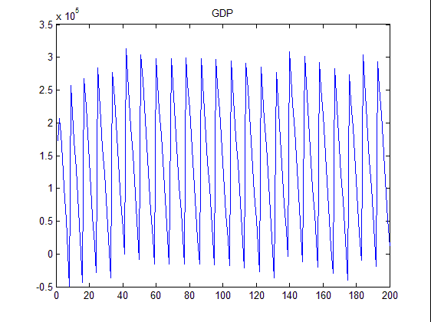
Simulation Scenarios – I.D.
A Dynamic Rule in Cellular Automata
k = 3
l = 3

Slide 23
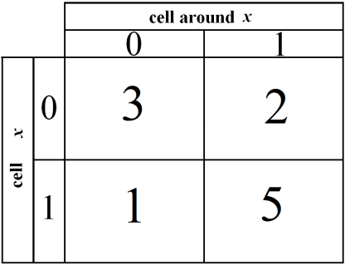
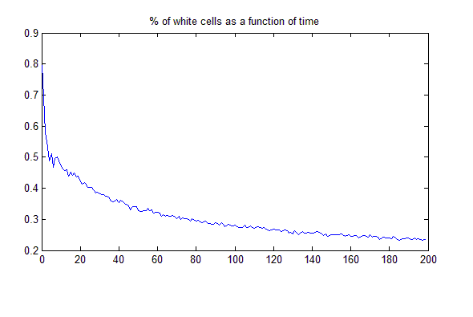
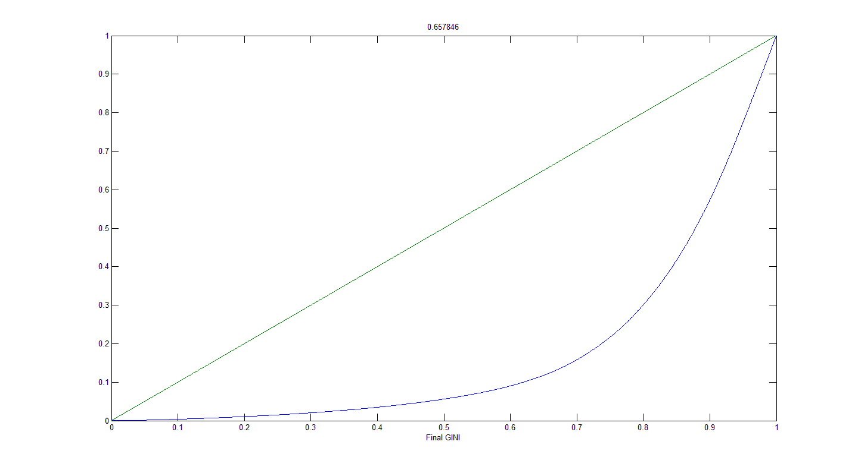
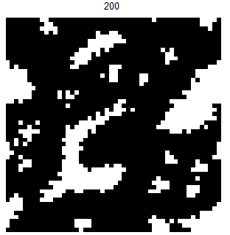
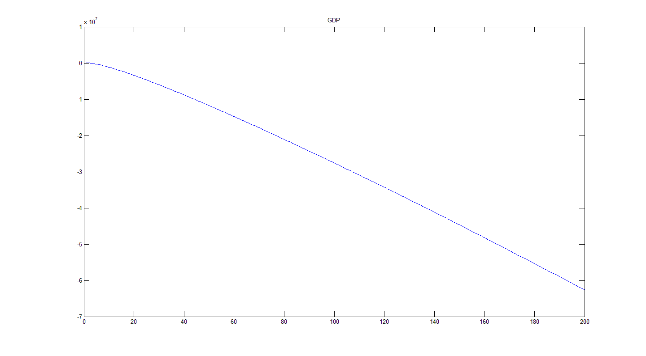
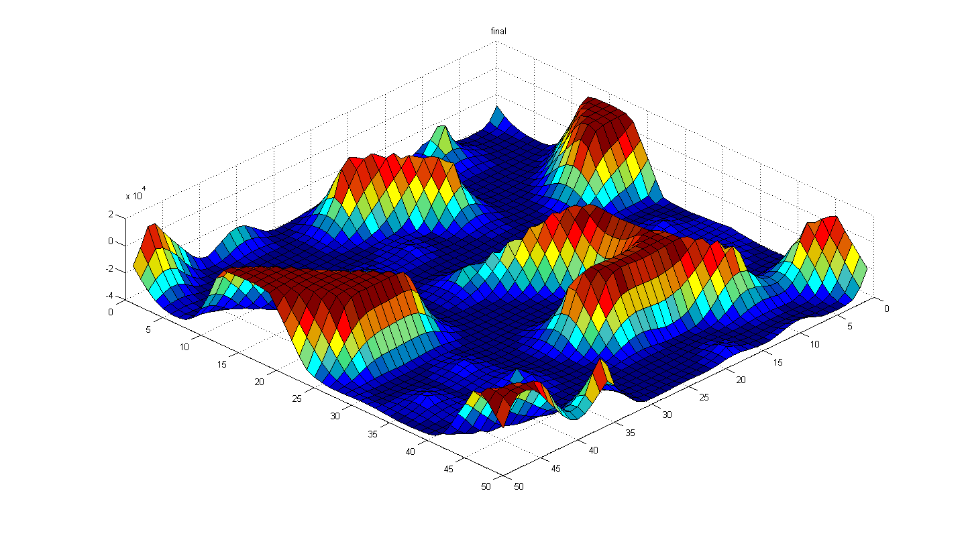
Simulation Scenarios – II.A.
A Dynamic Rule in Cellular Automata
k = 1
l = 1

Slide 24
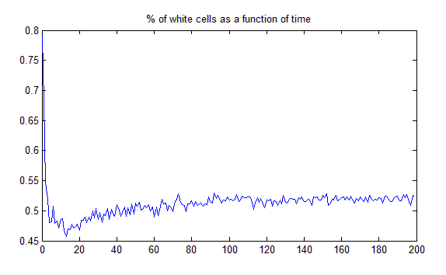
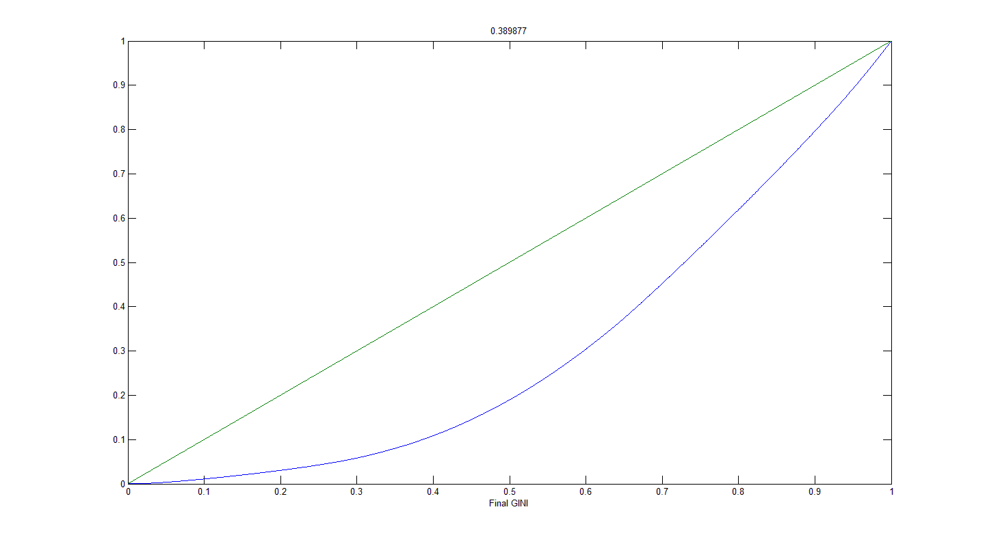
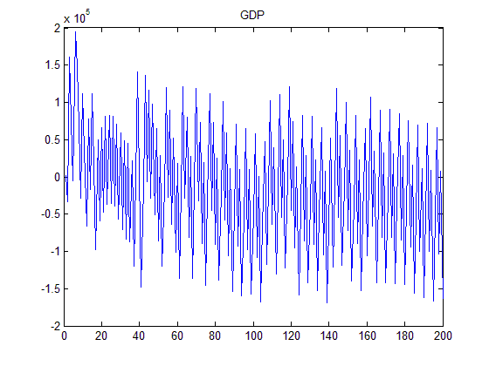
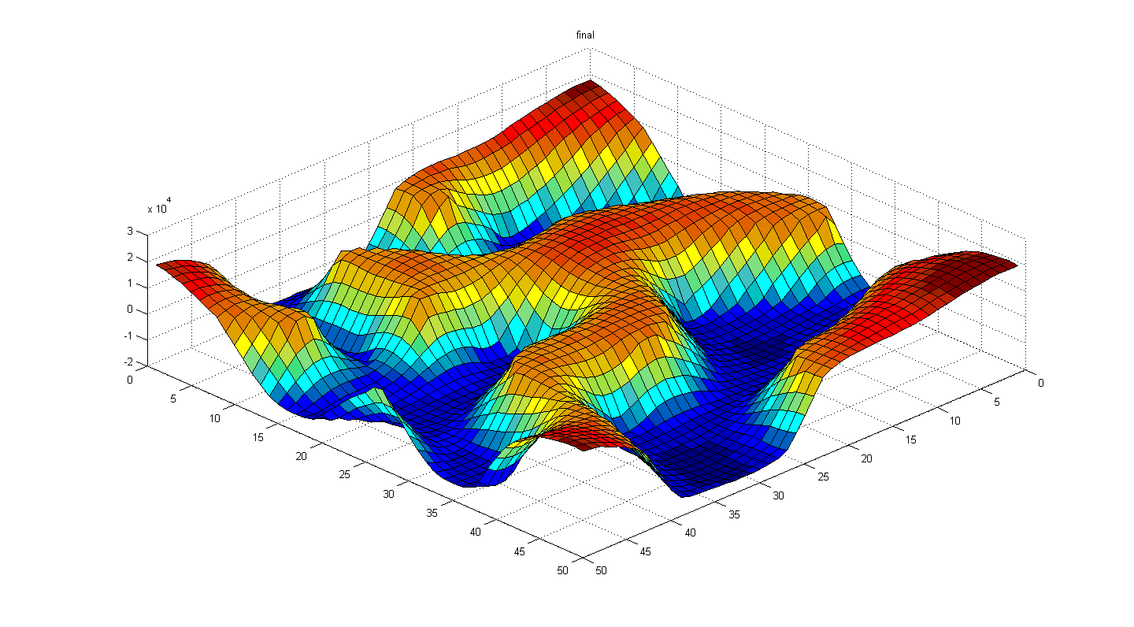
Simulation Scenarios – II.B.
A Dynamic Rule in Cellular Automata
k = 3
l = 3

Slide 25
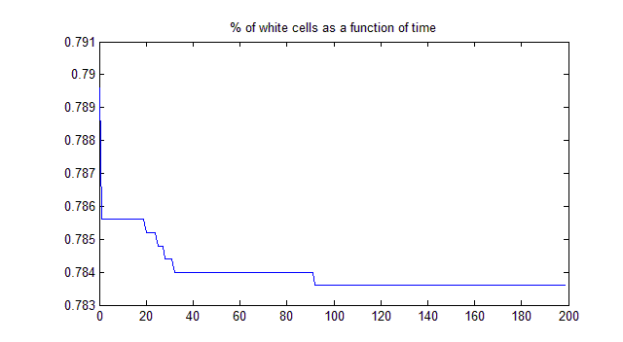
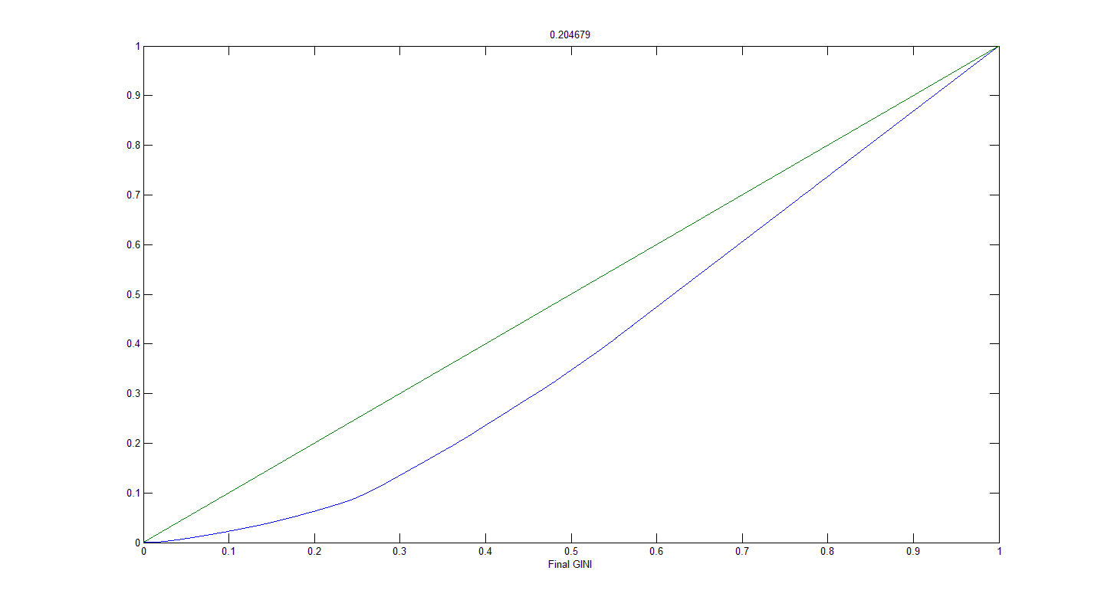
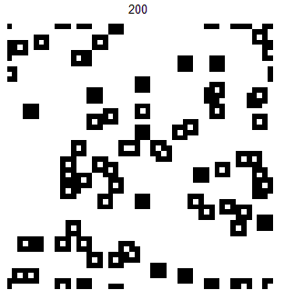
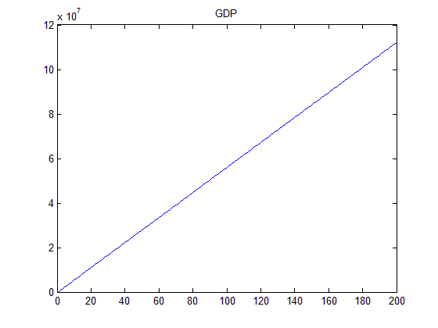
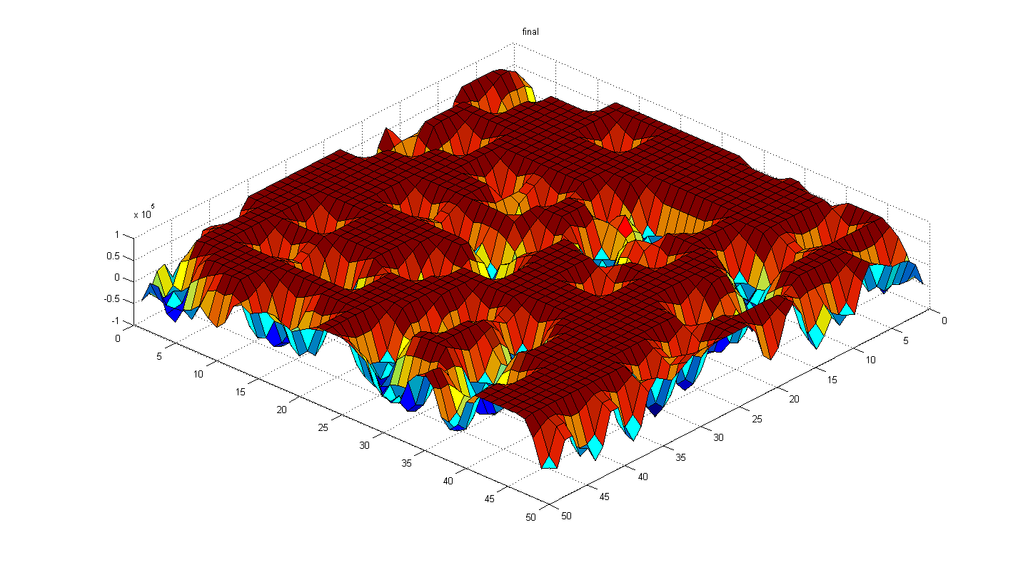
Simulation Scenarios – II.C.
A Dynamic Rule in Cellular Automata
k = 1
l = 1

Slide 26
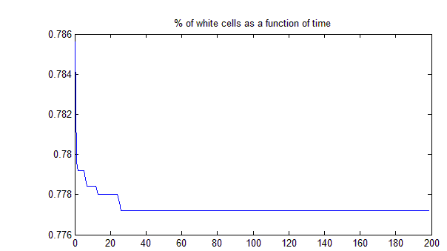
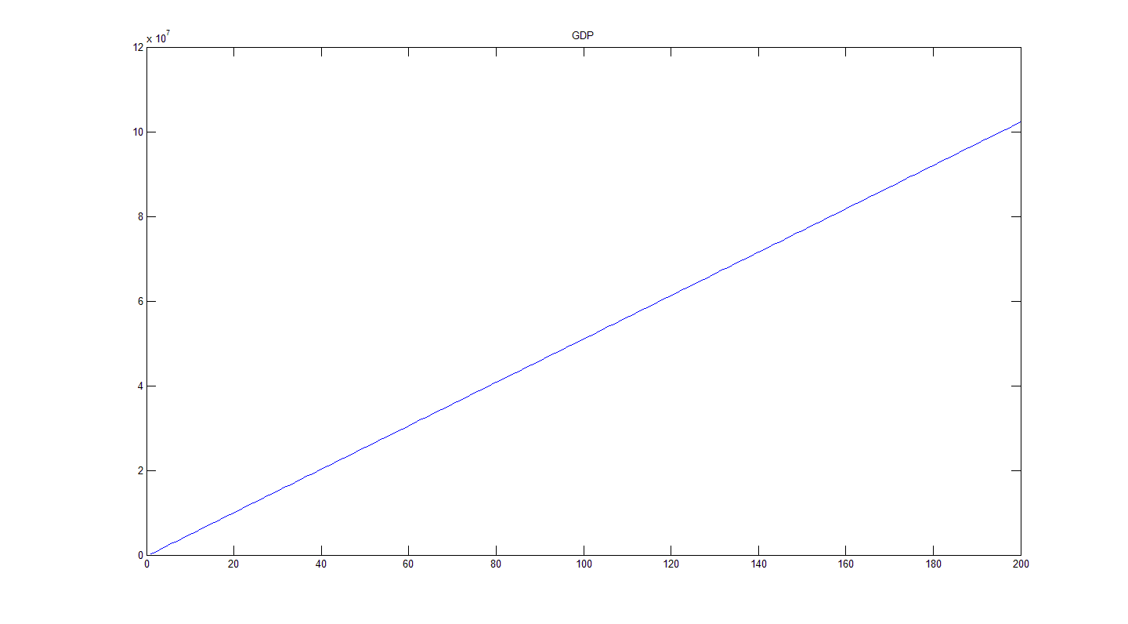
Simulation Scenarios – II.D.
A Dynamic Rule in Cellular Automata
k = 3
l = 3

Slide 27
Concluding Remarks
A Dynamic Rule in Cellular Automata
High inequality (GINI ~ 0.6 ) yields low levels of happiness.
Equal societies favor happiness.
Happiness / Income correlation is weak, when society favors equality.
Extreme inequality favors unhappiness.

Slide 28
References
A Dynamic Rule in Cellular Automata
C. Somarakis, J. Baras (2011). On the complexity of a Social Behavior Model, ICCS11.
A. Clark, P. Frijters, and M. Shields (2008). Relative income, happiness, and utility: An explanation for the Easterlin paradox and other puzzles. Journal of Economic Literature, 46(1). pp. 95-144.
A. Clark and A. Oswald (1996) Satisfaction and Comparison Income. Journal of Public Economics, 61:3, pp. 359-81.
C. Gini (1912). Variabilità e mutabilità (Variability and Mutability), C. Cuppini, Bologna, 156 pages. Reprinted in Memorie di metodologica statistica (Ed. Pizetti E, Salvemini, T). Rome: Libreria Eredi Virgilio Veschi (1955).
Ray, Debraj (1998). Development Economics. Princeton, NJ: Princeton University Press. p. 188. ISBN 0691017069.

